Slide 1

Internal Project Abstract Review
Effect of Thermo-Mechanical Treatment in Austenitic Condition on Flow Behaviour of Reduced Activation Ferritic-Martensitic Steel
NAME OF THE PROJECT GUIDE
Mr.G.KULADEEP
Names of the Project Batch students
S. Pavan kalyan Reddy 19121A03D2
P. Siva Teja 20125A0333
K. Muni Sai Kumar Reddy 20125A0327
D. Reddy Sekhar 20125A0324
SK. Mohammad Waseem 19121A03C9
Date : 24-12-2022

Slide 2
Title
Effect of Thermo-Mechanical Treatment in Austenitic Condition on Flow behaviour of Reduced Activation Ferritic-Martensitic Steel

Slide 3
Abstract
9Cr-1W-0.06Ta Reduced Activation Ferritic-Martensitic (RAFM) steel have been investigated in normalized and tempered (N+T) condition and for thermo-mechanical treated steel (TMT) in Austenitic and ferritic field conditions. This paper is aimed at modelling the flow behaviour of RAFM steel at high temperatures for N+T and TMT conditions. The plots of work hardening rate (θ) vs. stress (σ) revealed transient and stage-III stages of work hardening for both TMT and N + T steels is evaluated. However, the TMT processing increased the work hardening of the steel, as manifested by the shift in θ vs. σ plots to higher stresses at all the temperatures and an increase in the fraction of transient stage of θ vs. σ plot up to a temperature of 773 K. Further, an increase in stress to onset of stage-III and the decrease in rate of dynamic recovery (Stage-III) have been observed for TMT steel, in comparison to the steel in N + T condition. The obtained flow analysis results were correlated with microstructural investigation i.e., Optical, scanning and transmission electron microscopic investigations to assess the microstructural changes of the steel N+T and TMT conditions. Various stages in strain hardening behaviour of RAFM steel is evaluated analytically and compared with microstructural investigations.

Slide 4
Introduction :
Reduced activation ferritic/martensitic (RAFM) : steels are a possible structural material for fusion reactors because of their inherently excellent properties, such as strength, thermal conductivity, and irradiation resistance, compared with those of austenitic stainless steels.
Conventionally, the microstructure of RAFM steels was tempered martensite with a specific distribution of M₂₃C₆ carbides and MX carbonitrides after a normalizing and tempering treatment. The positive effects of microstructure refinement on microstructure stability, mechanical performance and even irradiation resistance were demonstrated by previous studies.

Slide 5
N+T condition :
Normalizing : is to heat the workpiece to AC₃ (Ac refers to the final temperature at which all free ferrite transforms to austenite during heating, generally from 727 ° C to 912 ° C) or AC_{m} (AC_{m} is the critical temperature line for complete austenitizing of eutectoid steel during actual heating) 30 ~ 50 ℃, after holding for a period of time, take out the metal that is cooled in the air or sprayed with water, sprayed or blown from the furnace Heat treatment process.

Slide 6
Tempering treatment means that the steel after quenching hardening or normalization treatment is cooled down at a certain rate after being immersed for a period of time below the critical temperature

Slide 7
Thermo-Mechanical Treatment :
Thermo-mechanical treatment is the simultaneous application to steel that involves heating and cooling.
It is to develop better properties in steel by refining its micro structure.
This heating technology is referred as hot rolling, in this process vast quantities of steel can be handled.
The purpose of TMT is to provide, by selective control of temperature and forming conditions, a final product with material properties which this particular material would never be able to reach under conventional production methods

Slide 8
Literature Review :
Development of India-specific RAFM steel through optimization of tungsten and tantalum contents for better combination of impact, tensile, low cycle fatigue and creep properties
Development of RAFM steel for nuclear applications with reduced manganese, silicon and carbon content
(

Slide 9
Methodology
(
Literature Review
Selection and Ordering of RAFM Steel components
Fabrication of RAFM Steel
Testing
Analyzing

Slide 10
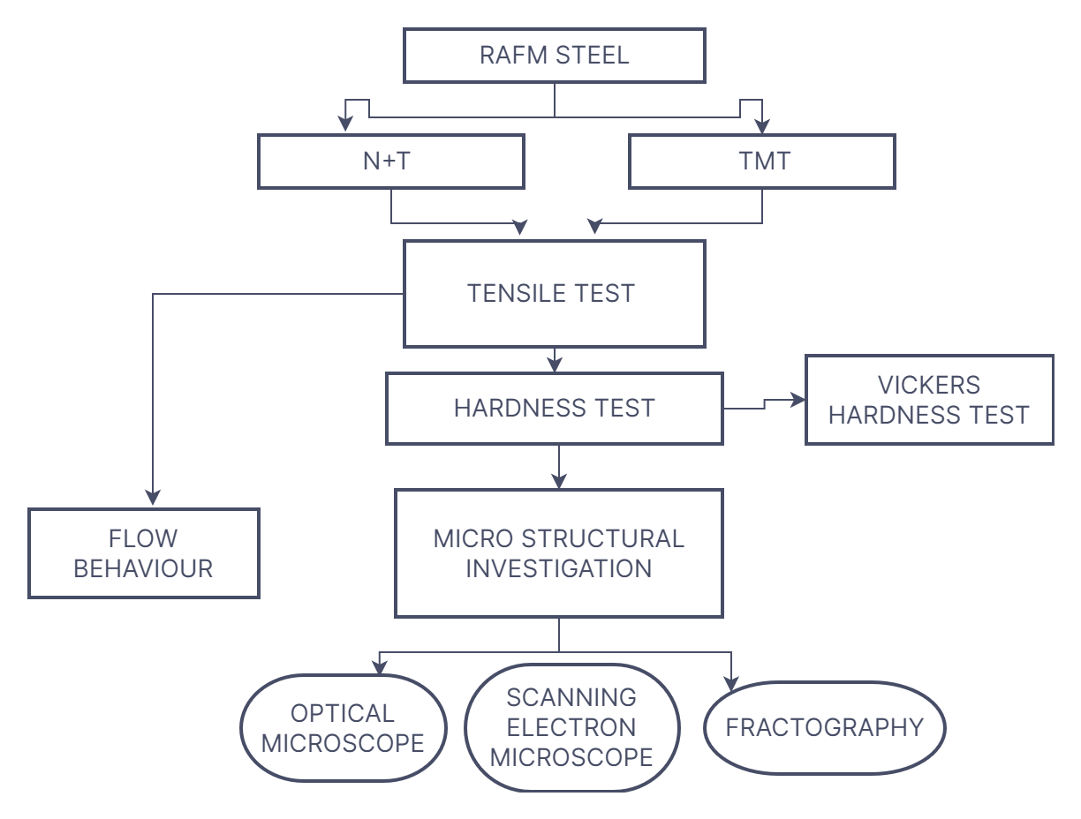
Problem Formulation :

Slide 11
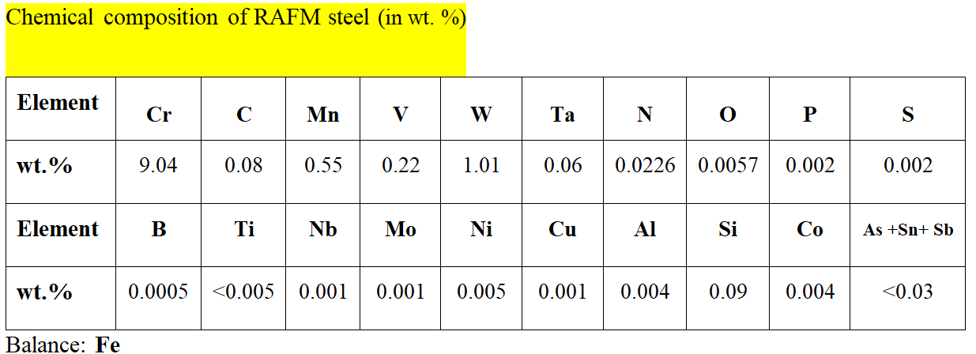
EXPERIMENTAL INVESTIGATIONS

Slide 12
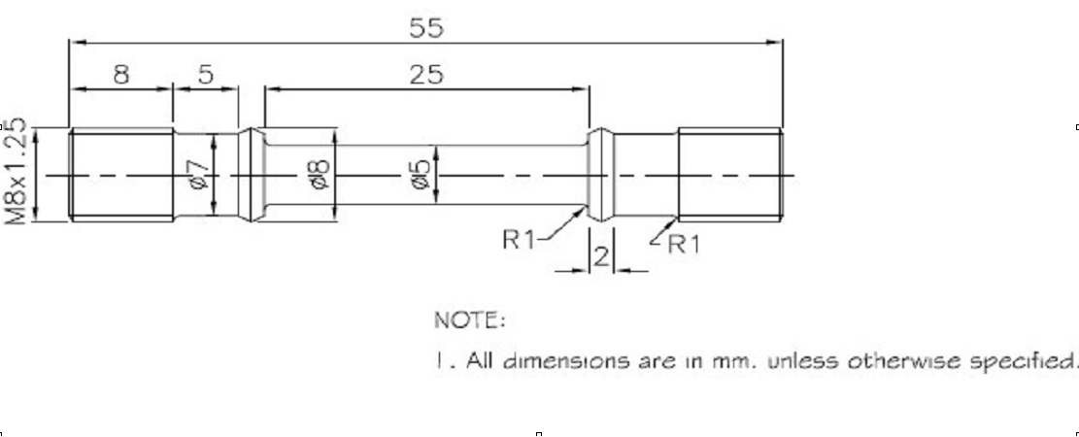
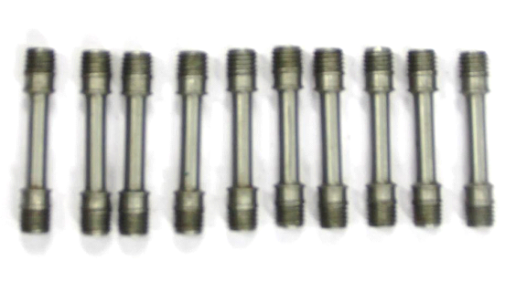
Schematic of standard tensile test
specimen (as per ASTM E8M)

Slide 13
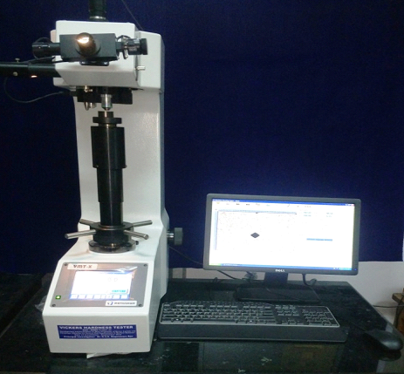
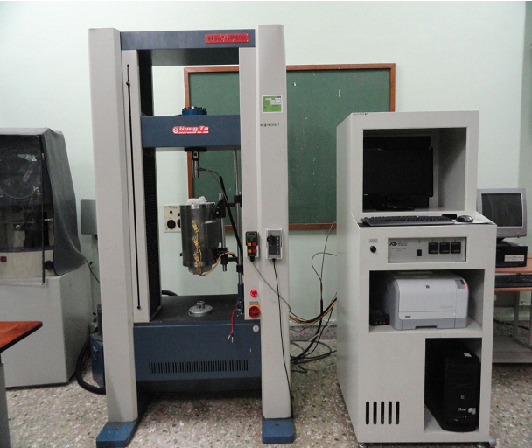
Vickers Hardness Tester
Tensile Test setup

Slide 14
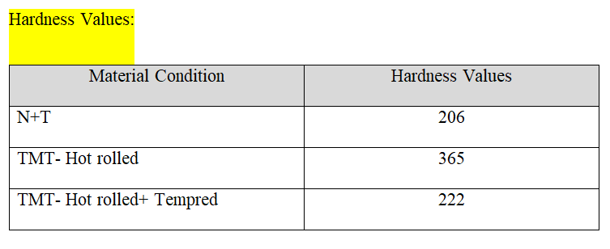
Hardness Test Results

Slide 15
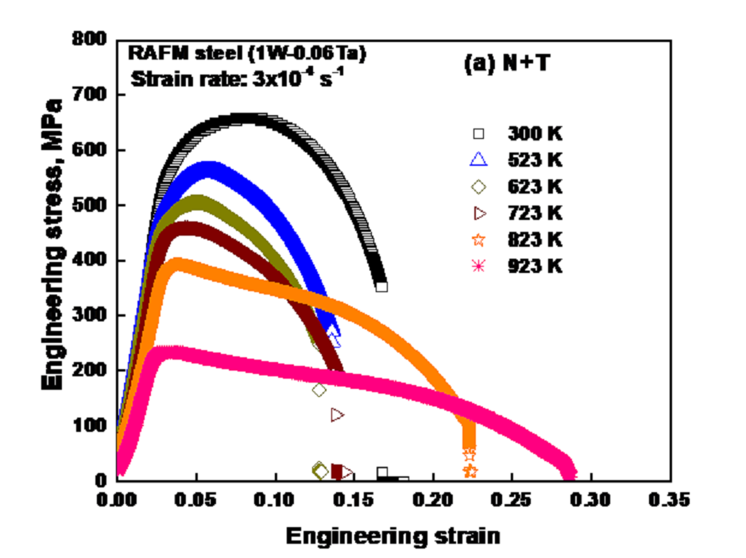

Slide 16
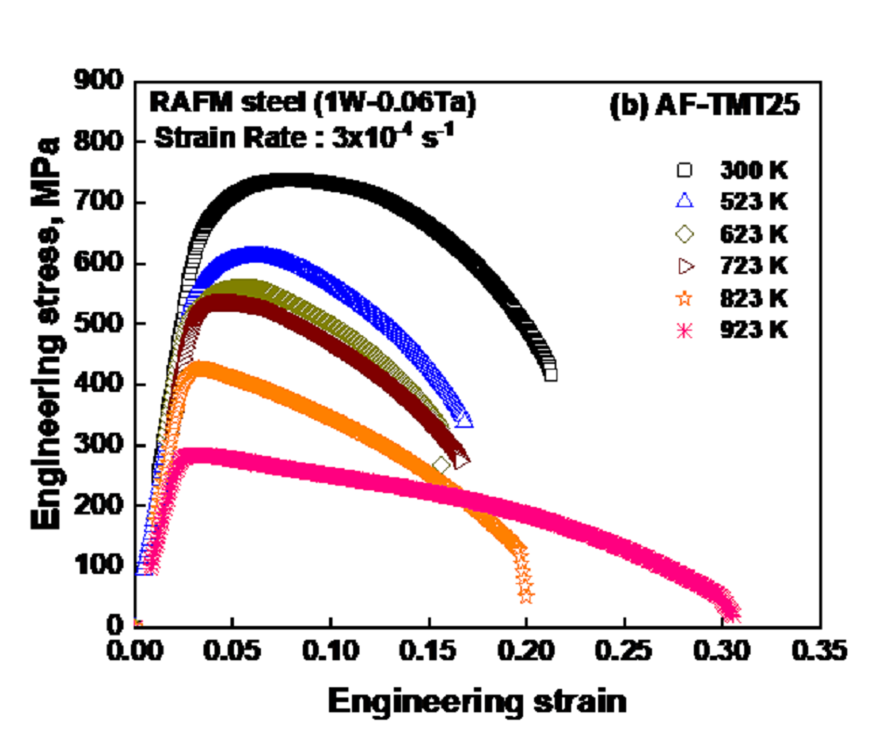

Slide 17
Status of results till date
TMT enhanced the tensile strength properties of RAFM steel without loss of ductility and is attributed to the refinement in microstructural features (lath width, precipitate size and distribution) of RAFM steel upon TMT.
The steel in AF-TMT25 condition exhibited higher YS and UTS than the steel in N+T condition.
The steel in AF-TMT25 condition exhibited a higher % elongation than the steel in N+T condition

Slide 18
Overall status of the project
60% of the project completed:
Literature Review
Selection and Ordering of RAFM Steel
Fabrication of RAFM Steel
Testing and Analysis
Flow Behaviour
Final Results

Slide 19
References
[1] R. L. Klueh and D. R. Harries, High-Chromium Ferritic and Martensitic Steels for Nuclear Applications, ASTM Monograph, ASTM International: West Conshohocken, (2001). https://doi.org/10.1520/MONO3-EB.
[2] A. Kohyama, Y. Kohno, K. Asakura, R&D of low activation ferritic steels for fusion in japanese universities, J. Nucl. Mater. 212–215 (1994) 684–89.
[3] N. Baluc, D.S. Gelles, S. Jitsukawa, A. Kimura, R.L. Klueh, G.R. Odette, B. van der Schaaf, J. Yu, Status of reduced activation ferritic/martensitic steel development, J. Nucl. Mater. 367-370 A (2007) 33–41. https://doi.org/10.1016/j.jnucmat.2007.03.036.
[4] S.N. Rosenwasser, P. Miller, J.A. Dalessandro, J.M. Rawls, W.E. Toffolo, W. Chen, The application of martensitic stainless steels in long lifetime fusion first wall/blankets, J. Nucl. Mater. 85–86 (1979) 177–182. https://doi.org/10.1016/0022-3115(79)90487-2.
[5] D.R. Harries, Ferritic Steels for Use in Nuclear Energy Technologies, in: J.W. Davis, and D.J. Michel (Eds.), Proc. Top. Conf., The Metallurgical Society of AIME, 1984: p. 141.

Slide 20
THANK YOU

